Slide 1
Introduction To Programming

Slide 2
Content
String

Slide 3
String
C++ uses the <string.h> header file to provide the prototypes.
Most frequently used functions: strlen(), strcat(), strcat(), strcmp(), strncmp(), strcpy(), and strchr().
#include<iostream>
#include<string.h>
Using namespace std;

Slide 4
String...
strcat (s1, s2)
#include<iostream>
#include <string.h>
using namespace std;
int main()
{
char course1[]= "My course is: ";
char course2[]= "C++";
strcat(course1, course2);
cout<<course1;
return 0;
}

Slide 5

String...
strcmp (s1, s2)
#include<iostream>
#include <string.h>
using namespace std;
int main()
{
cout<<strcmp("HE","SHE")<<endl;
cout<<strcmp("SHE","SHE")<<endl;
cout<<strcmp("SHE","HE")<<endl;
cout<<strcmp("HEE","SHE")<<endl;
return 0;
}

Slide 6
String...
strcpy (s1, s2)
#include<iostream>
#include <string.h>
using namespace std;
int main()
{
char course1[]= "C++";
char course2[5];
strcpy(course2, course1);
cout<<"Course is: "<<course2;
return 0;
}

Slide 7
String...
strlen (s)
#include<iostream>
#include <string.h>
using namespace std;
int main()
{
char course[]= "C++";
int length = strlen(course);
cout<<"Length is: "<<length;
return 0;
}

Slide 8
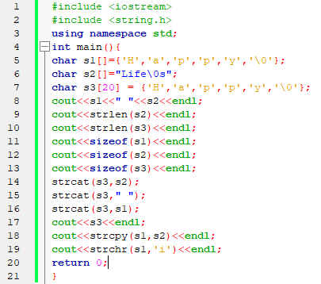
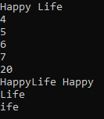
String…

Slide 9
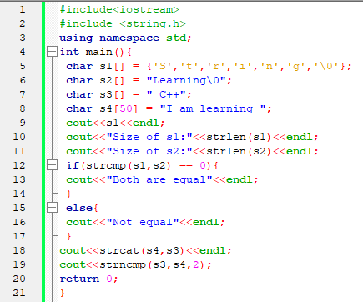

String...

